Slide 1
WEBCAST
Practical Open Source Intelligence
OSINT for Defenders:
Adventures in Honeytokens and Leaked Data
Micah Hoffman (SANS Certified Instructor) @WebBreacher
Justin Henderson (GSE # 108) @SecurityMapper

Slide 2
Welcome!
A copy of this talk is available at:
https://github.com/HASecuritySolutions/presentations
https://github.com/WebBreacher/presentations
More free stuff:
https://github.com/HASecuritySolutions

Slide 3


About Us
Micah Hoffman
Author of SEC487: Open-Source Intelligence Gathering and Analysis
@WebBreacher, https://webbreacher.com
Justin Henderson
Author of SEC555: SIEM with Tactical Analytics
GIAC GSE # 108, Cyber Guardian Blue and Red
59 industry certifications (need to get a new hobby)
@SecurityMapper, https://www.hasecuritysolutions.com

Slide 4
HALO (Honeytokens Against Leveraging OSINT)
Fake users can be created publicly to combat recon
Could be just in hidden metadata and/or key public sites
Example: Peter Parker(pparker@sec555.com)
On LinkedIn, Facebook, Adobe, PGP, GitHub, etc.
Likely to be picked up during OSINT
May eventually make compromised account lists
Takes minimal time to set up… can get fairly elaborate
Activity from this account is malicious and provides context

Slide 5
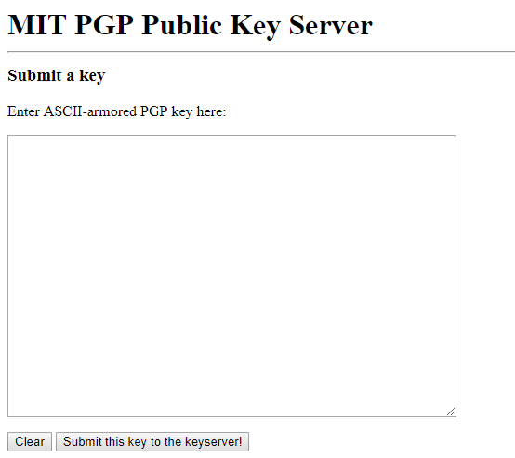
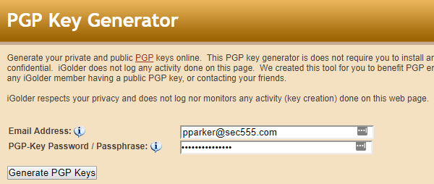
PGP Key Generation
Easy to generate PGP keys
Free
Lots of online generators
Submit to key server(s) --->

Slide 6
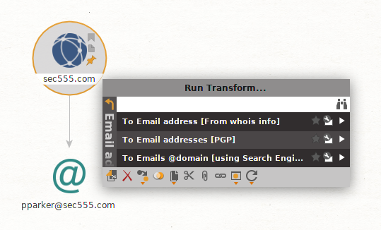
Maltego
Reverse engineering OSINT tools proves honeytokens are:
Placed appropriately
Weaponized for early detection
Example: Maltego
Enter company domain
Performs many OSINT tasks
WHOIS lookups
PGP key identification
Search engine/social media/etc.

Slide 7
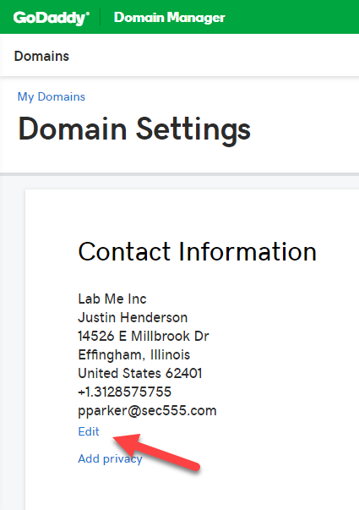
Domain Whois Information
Another token location
Domain registration information
Domain registrations may have:
Individual information
Address
City, State, Zip
Email addresses
Information may be anonymous
More fun to use honeytoken

Slide 8
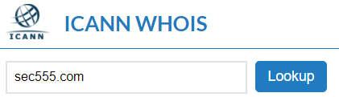
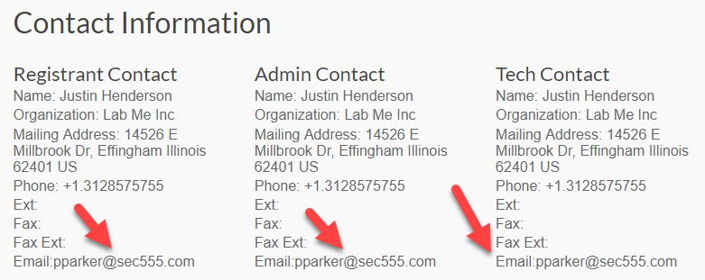
WHOIS
Many OSINT tools query WHOIS servers
Maltego
Recon-NG
SpiderFoot
Manual lookups

Slide 9

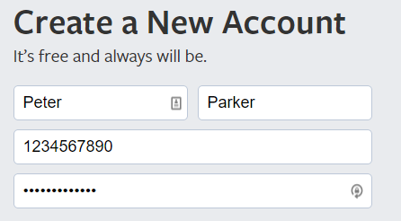
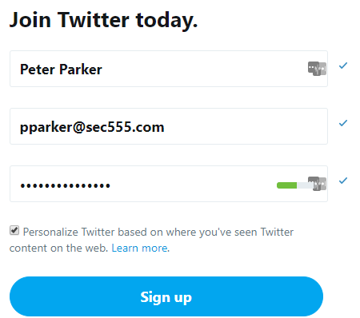

Social Media
Entries in social media are discoverable to many tools
Such as Facebook, Twitter, LinkedIn
As well as online web pages

Slide 10
Automated Searches
theharvester -d sec555.com -l 500 -b google
[ - ] Searching in Google:
Searching 0 results...
Searching 100 results...
Searching 200 results...
Searching 300 results...
Searching 400 results...
Searching 500 results...
[+] Emails found:
-------------------
pparker@sec555.com

Slide 11
Monitoring Your Internets
Goal: Discover relevant organizational content
"What are we putting on the internet?"
"What are others posting about us on the internet?"
Actions to Achieve Goal:
Discover content
Examine content for words/patterns
Monitor and alert on keywords

Slide 12
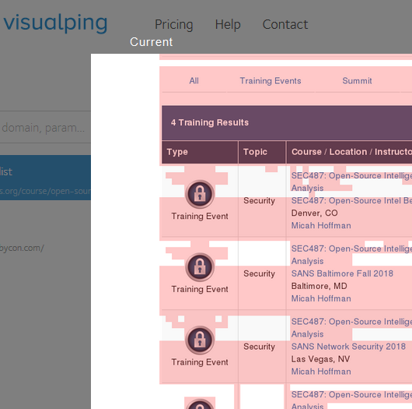
Monitoring Web Site Changes
Alerts when a page/part of a page on a web site changes
Technique used to monitor any internet-facing web site
Your sites
Your competitor sites
Social Media sites
Notes:
Do your devs let you know when new content is being pushed to the internet?

Slide 13
Free Resources for Web Page Monitoring
https://visualping.io
62 checks/month (~2 sites daily for 1 month)
Neat slider view for changes
https://versionista.com
5 sites, checked up to 3 times daily
Shows changes over time

Slide 14
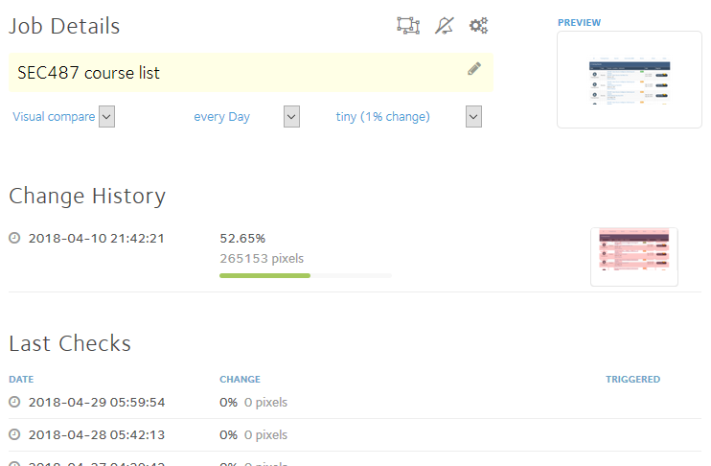
VisualPing (1)
Graphical change viewer

Slide 15
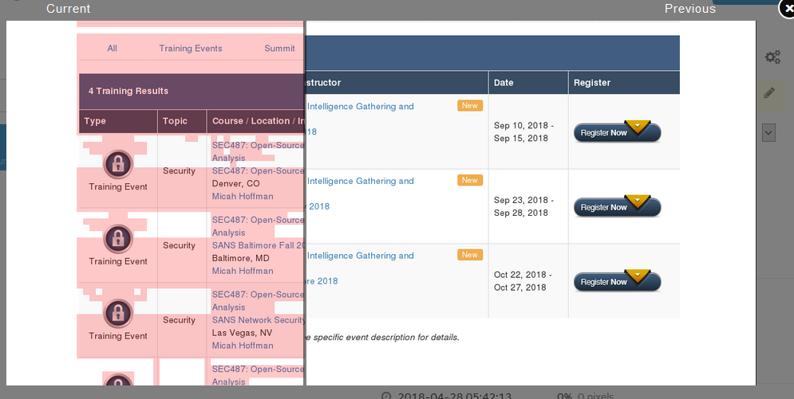
VisualPing (2)
Graphical change viewer using a slider to show or hide content

Slide 16
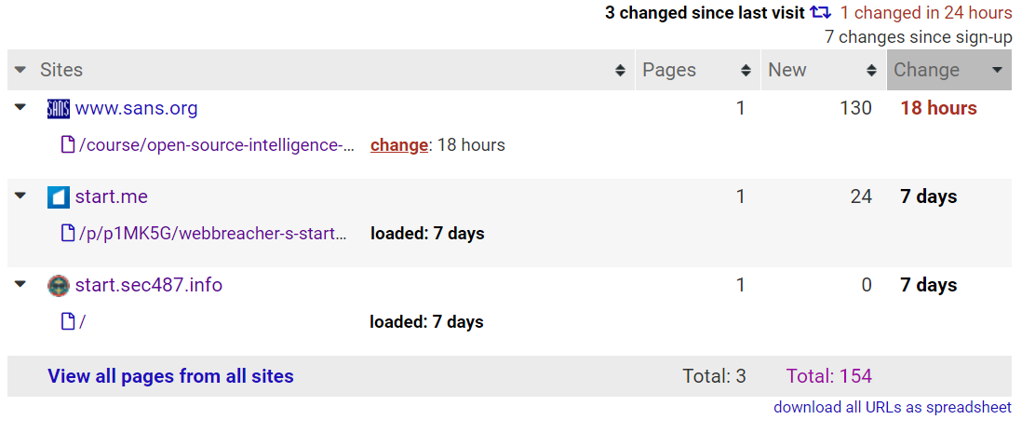
Versionista.com (1)

Slide 17
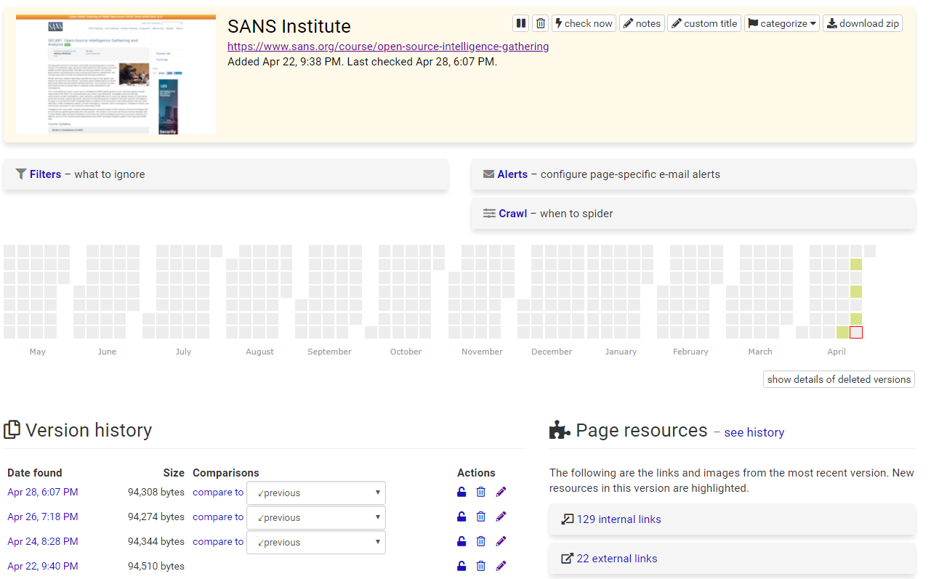
Versionista.com (2)
Shows changes over time

Slide 18
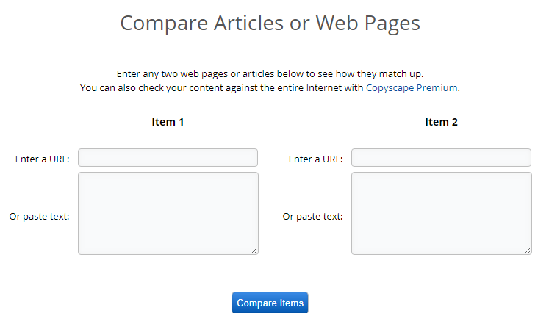
Comparing 2 Web Pages
Don't want to sign up for a monitoring service but need to compare 2 web pages?
Consider using a service like https://www.copyscape.com/compare.php

Slide 19
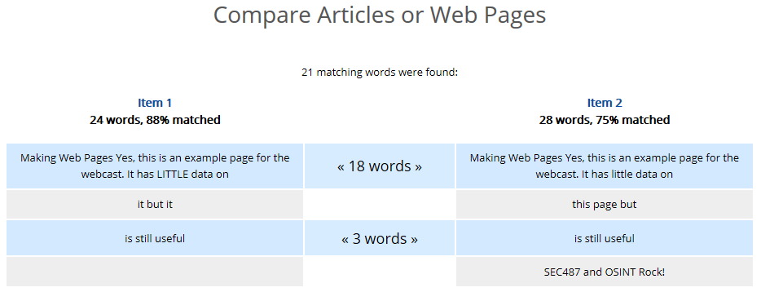
Copyscape.com Results

Slide 20
Examining Web File Contents
You may need to monitor for content inside of files posted to the internet
Is there "sensitive" content within?
Phone numbers / Email Addresses / User names
Internal data: Printer names / File paths or locations
Privacy data: Country/State ID numbers / Health info
For OSINTers/pentesters, is there "useful" info in them?

Slide 21
Retrieving the Web Files Using Wget
Switches of Interest
-e robots=off (Don't use robots.txt file
--no-check-certificate (Ignore HTTPS issues)
-A [extensions]
-r (Recursive)
-nd (Don't create directory structure, put files in 1 directory)
-l# (How many levels to recurse?)
Wget
Installed by default on most macOS and Linux systems
Windows binaries exist (also Cygwin/Windows Subsystem for Linux)
Example: Retrieve only PDFs from a site
$ wget -nd -r -l3 -e robots=off --no-check-certificate -A .pdf http://www.thirdpresbyterian.org/

Slide 22
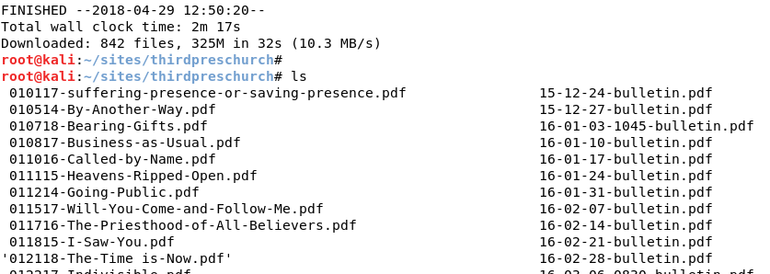
Wget Results

Slide 23
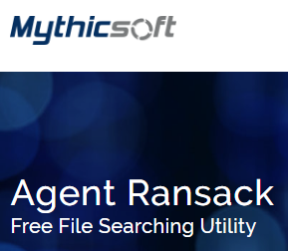
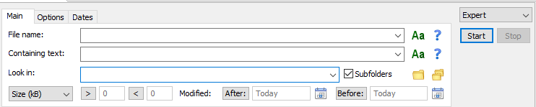
Examining File Content (Windows)
https://www.mythicsoft.com/agentransack/
(Free!)
FileLocatorPro (~$50) Excellent extension of this

Slide 24
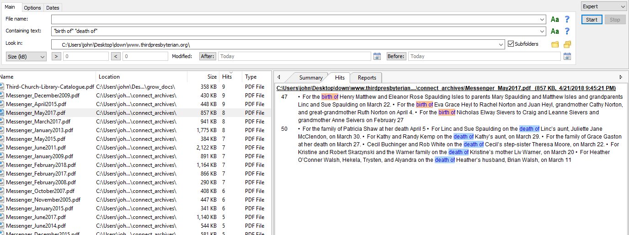
Agent Ransack Results for "birth of" or "death of"

Slide 25
Grep'ping It
grep - Commandline/terminal tool for finding content
Free and built-in on macOS, Linux
On Windows
Install binaries via Cygwin/Linux Subsystem
Use the GnuWin binaries (http://gnuwin32.sourceforge.net/)
Use "findstr" built-in command and alter your syntax

Slide 26
Converting Content Format
Some tools may not be able to read the PDF (or other file formats)
We may need to convert from one format into text
Let's look at two such conversions:
PDF to text - pdftotext
Image to text - OCR

Slide 27
PDFtotext (Linux Command)
Converts PDFs to Text (what else would it do?)
To run on a directory full of files, run:
for i in `ls *.pdf`;do pdftotext $i;done
This lists all *.pdf files in a directory and runs them through the pdftotext application
In the directory, you will have *.pdf and *.txt files

Slide 28
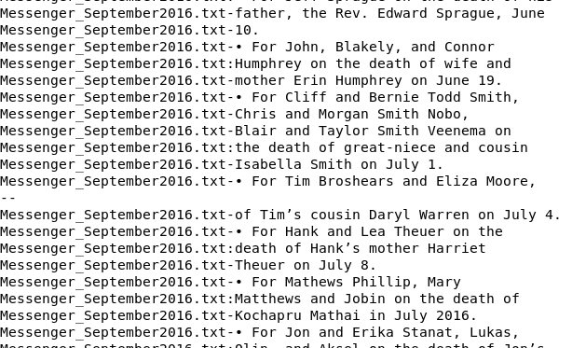
Grep Results for "birth of" or "death of"
grep -A2 -B2 -i -E "(birth|death) of" *.txt
Using a regular expression, we can quickly find our data

Slide 29
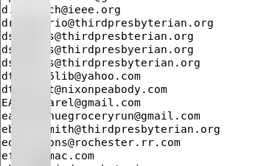
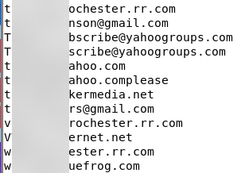
Grep Results for Email Addresses
grep -o -h -E "\b[a-zA-Z0-9.-]+@[a-zA-Z0-9.-]+\.[a-zA-Z0-9.-]+\b" *.txt | sort -i -u
Some false positives (Misspellings, conversion errors, etc)
334 Unique emails found
Notes:
Regex from https://www.putorius.net/2011/12/grep-all-email-addresses-from-text-file.html

Slide 30
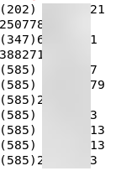
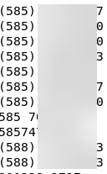
Grep Results for US Phone Numbers
grep -o -h -E "\(?[0-9]{3}\)? ?[0-9]{3}[-\. ]?[0-9]{4}" *.txt|sort -u
Some false positives
24 Unique numbers found
Notes:
Regex from https://www.putorius.net/2011/12/grep-all-email-addresses-from-text-file.html

Slide 31
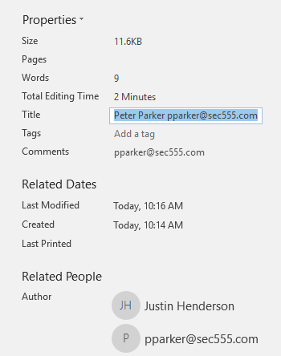
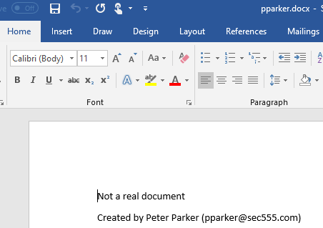
File Metadata
Tools like Foca crawl public documents
Can be content of file
Often uses meta data about file ---->

Slide 32
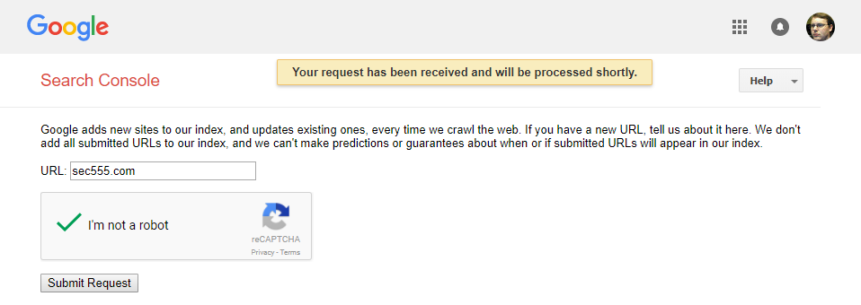
Submit Site to Web Crawler
First add token file to public web server
Then tell web crawlers to re-scan the public server
Will happen naturally over time (this speeds it up)

Slide 33
What About Image File Searching?
Using Object Character Recognition (OCR), we can extract some text from images
On Linux, use Tesseract
Might already be installed in your OS and is at https://github.com/tesseract-ocr/tesseract
Usage:
Download an image with text content in it
Run Tesseract on it
Receive text output
#profit

Slide 34
Tesseract via PowerShell
Positronic-IO provides same capabilities for Windows via PowerShell module PSImaging
PowerShell module available at https://github.com/Positronic-IO/PSImaging
Usage:
Install module
Scan files
Easy for Windows admins to adopt
Scan multiple servers
Multiple file shares/folders
Finds data in unauthorized locations (internal or external)

Slide 35

Example Using PowerShell PSImaging
"Random Sample Image"
PS C:\> Export-ImageText -Path "C:\Slide Deck - SEC487.jpg"
SEC487: OPEN-SOURCE
INTELLIGENCE GATHERING
AND ANALYSIS
SANS
BETA #2 -DENVER, co 7”‘
JUNE 4-9, 2018 J-
SPECIAL PRICING: $3,105
The course will teach you current, real—world skills,
techniques, and tools that law enforcement, private
investigators, cyber attackers, and defenders use to
scour the massive amount of information across the "
Internet, analyze the results, and pivot on interesting V
pieces of data to find other areas for investigation. * Vq 7;

Slide 36
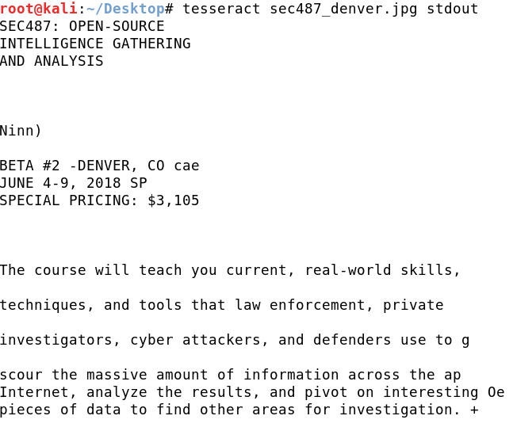
Example Using Tesseract

Slide 37
Wrapping It Up
Consider using honey tokens to monitor and alert upon attacker recon and attack activities
Set alerts to let you know when changes are made to "important" web pages
Use tools to look for sensitive content within the files your organization posts to the internet

Slide 38
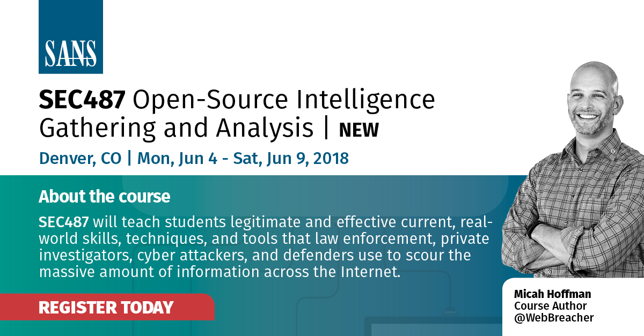
SEC487: Open-Source Intelligence Gathering and Analysis
https://www.sans.org/sec487
6 days, 36 CPEs
24 hands-on labs
Geared towards everyone: beginner to expert

